Slide 1
PredictiveAnalytics
Machine Learning in Health Care
2020 Data Analytics Final Project
University of Toronto Continuing Education
By: Ryan Worm and Darren LeFort

Slide 2

We have a problem
ICU capacity
Infection and mortality rate
Pharmaceutical shortages
Treatment delays
Psychological burnout & PTSD

Slide 3
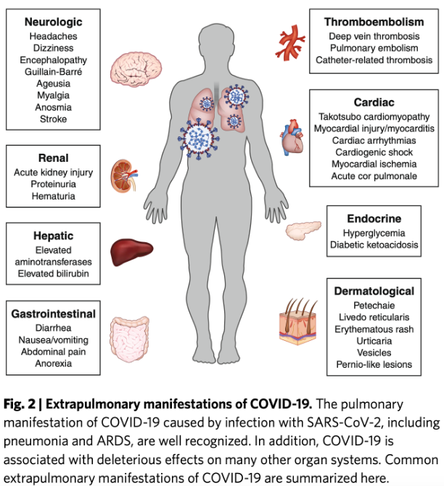
Feeding the problem
Heart disease: number one killer worldwide
31% of all death (17.9 million annually)
Heart disease prediction is one of the most important subjects in healthcare analytics
Multisystem inflammatory disease
Long term implications of COVID-19
https://afludiary.blogspot.com/2020/08/j-neurology-covid-19-as-potential-risk.html
Notes:
Left sided heart failure

Slide 4
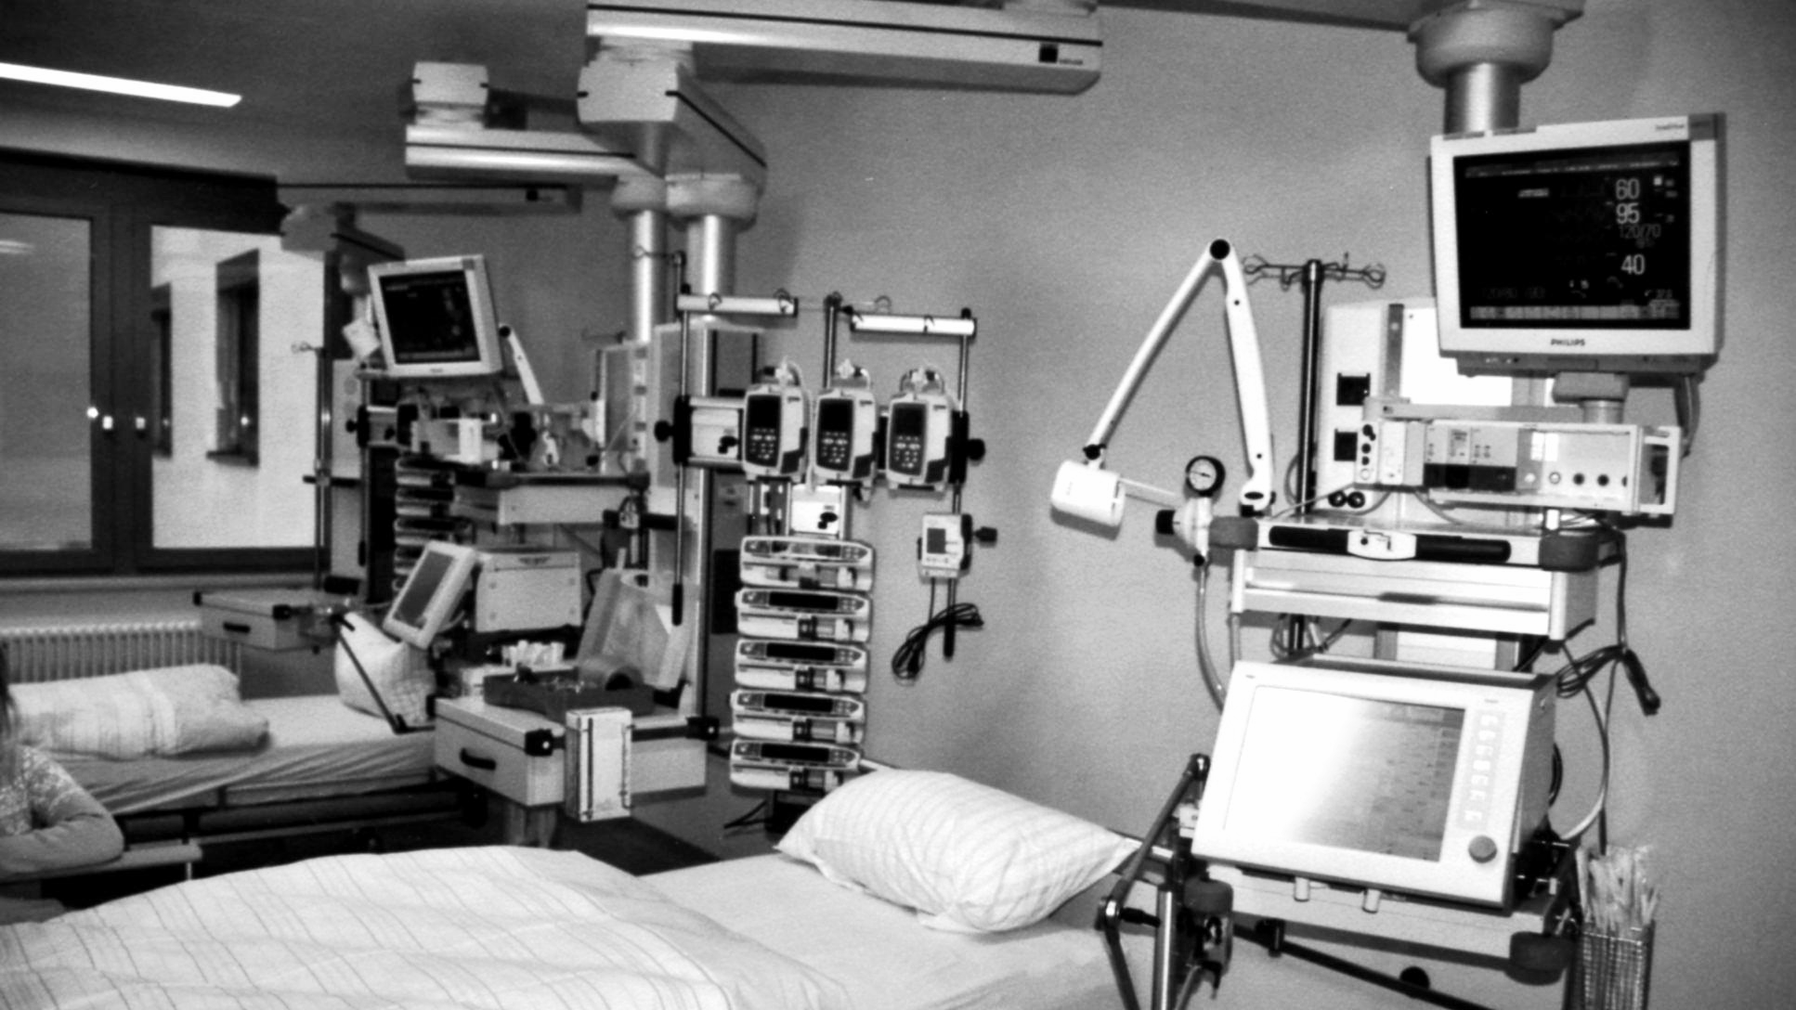

Annual cost of heart disease

Slide 5
$21.2 billion
Hypertension is responsible for $273 million in Ontario alone
In direct (medical) and indirect (lost earnings)

Slide 6

Predictive Analytics
To help unburden the load machine learning can be used to help identify high risk patients such as those who are at risk of developing heart disease.
Early intervention helps improve outcomes without needing to more expensive emergency treatments.

Slide 7

Mission statement:
Focusing on data to proactively improve real life health implications.

Slide 8
Framington Heart Study
Pioneer study in cardiovascular pathophysiology
Ongoing
Multiple generations
Expanded scope

Slide 9
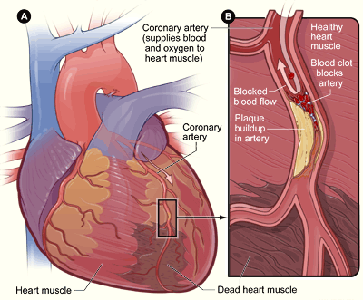
Predicting CHD
What is it?
Symptoms
Risk Factors:
Environmental
Age
Sex
Lifestyle
Genetics
Notes:
Vascular compliance
Peripheral resistance and left sided heart failure
Systolic pressure

Slide 10
Demonstration
Demo page

Slide 11
Machine Learning

Slide 12
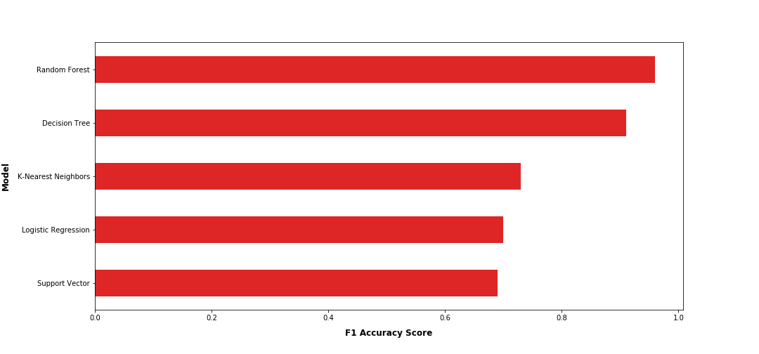
F1 accuracy scores
Random Forest: 0.96
Decision Tree 0.91
K-Nearest Neighbors 0.73
Logistic Regression 0.70
Support Vector 0.69

Slide 13
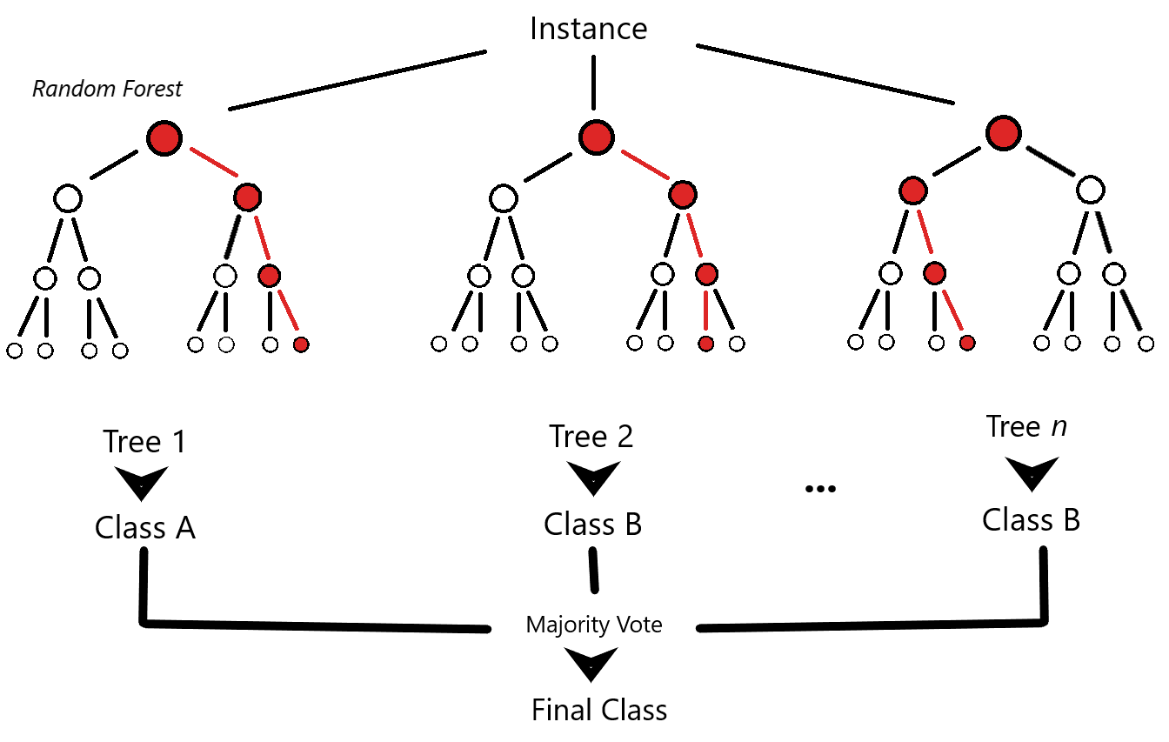
Random Forest
Key Attributes
Systolic blood pressure: .174
Age: .165
BMI: .150
Total Cholesterol: .135
Glucose: .126

Slide 14
Random Forest vs Decision Tree
Key Attributes (Random Forest)
Systolic blood pressure: .174
Age: .165
BMI: .150
Total Cholesterol: .135
Glucose: .126
Key Attributes (Decision Tree)
Systolic blood pressure: .166
Age: .164
BMI: .150
Total Cholesterol: .150
Glucose: .138
Notes:
Differences between random forest and decision tree
Greater variance in weighting for random forest

Slide 15




Our product - Opportunities
Health Care Professionals:
Treatment plan design and forecasting
Streamlining family medicine, outreach
Patient compliance
General Public:
Education
Dieting and fitness apps
Games (Ring fit, Wii Fit)

Slide 16
Project Milestones
Data Search
Data Cleaning
Front End
Data Selection
Machine Learning
Deploy
Brainstorming ideas with available sources
Jupyter Notebook (python) utilized to format data.
Web page intake form and results page developed.
Step 1 |  | Step 2 |  | Step 3 |  | Step 4 |  | Step 5 |  | Step 6
Cardiovascular Disease data set chosen
Model trained and tested.

Slide 17
Project Limitations
Data Search
Data Cleaning
Front End
Data Selection
Machine Learning
Deploy
Prohibitive data
Step 1 |  | Step 2 |  | Step 3 |  | Step 4 |  | Step 5 |  | Step 6
Unsophisticated medical data set, cohort not specified
Overtraining threshold - Industry standards?
Notes:
Unsophisticated medical data set: Laboratory results as well as health history and physical results would provide significantly more useful data, legal and ethical obligations depending on deployment.
Machine learning: Would need to talk to healthcare scientists regarding weighting, training parameters.

Slide 18

Questions
Image: Alex Antoneshyn, edmonton.ctvnews.ca

